Slide 1

Search & Sort Algorithms

Slide 2

Search Algorithms

Slide 3
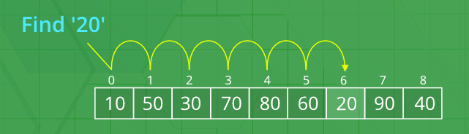
Search Problem
The search problem is finding a specific value (typically called a key) in a collection of data.

Slide 4
List of Search Algorithms
There are several known search algorithms:
Linear Search
Binary Search
Jump Search
Interpolation Search
Exponential Search
Sublist Search
Fibonacci Search

Slide 5
What is a LINEAR search algorithm?
The linear search algorithm (also called sequential search) is a very simple algorithm which uses a loop to sequentially step through each piece of data (one at a time), starting at the beginning, and then stop when either the value is found or at the end of the data (value not found)

Slide 6
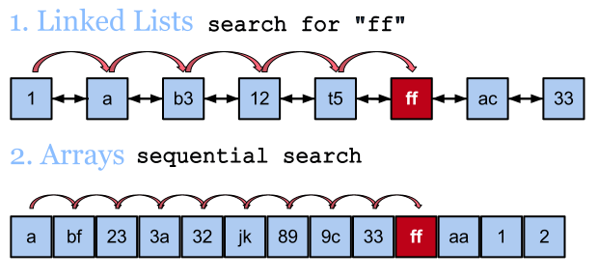
Examples of Linear Search Algorithms

Slide 7
Linear Search Animation

Slide 8
Algorithm Visualizations
David Galles, Associate Professor in the Computer Science Department at the University of San Francisco, created an awesome website to help students understand various algorithms by demonstrating them with visualizations.
Here is the link to the website page for search algorithms:
https://www.cs.usfca.edu/~galles/visualization/Search.html

Slide 9
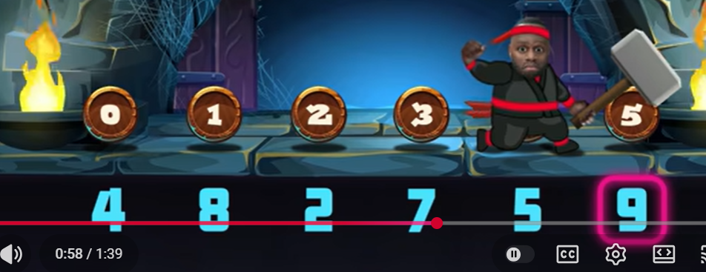
Linear Search by Too Tall Productions
https://www.youtube.com/watch?v=UU5QAJ1XMqQ

Slide 10
Linear Search Example
linearSearch.cpp

Slide 11

Linear Search Good Bad and Ugly
GOOD:
Simple, easy to understand
Doesn’t require data to be stored in any particular order
Space Efficient – doesn’t take up much space to run
BAD:
Time Inefficient – really slow, especially as the number of items you are searching for increases.

Slide 12
Number of Comparisons in Linear Search Algorithm
AVERAGE: n/2 comparisons
MAXIMUM: n comparisons
So, for a list/array of n items, the linear search will typically locate an item in n/2 attempts (assuming the item you are searching for is actually in the list/array). However, if the item is not in the list/array, the algorithm will compare all n items. - this is called the worst-case efficiency.

Slide 13
Runtime of Linear Search Algorithm
An algorithm’s runtime is the time the algorithm takes to execute.
Runtime of linear search algorithm:
1,000,000-element list = 1 second (runtime)
10,000,000-element list = 10 seconds (runtime)
(100 million) 100,000,000-element list = 100 seconds (runtime)
(200 million) 200,000,000-element list = over 3 minutes (runtime)
Imagine searching for a product on Amazon.com using linear search, which has 353,710,754 products listed that has to be searched as of January 29, 2021.

Slide 14
What is a BINARY search algorithm?
The binary search algorithm is much more efficient than the linear search.
Instead of testing data starting from the beginning, this algorithm starts with the item in the middle. If that element contains the desired value, then the search is over.
Otherwise, the value in the middle element is either greater than or less than the value being searched for. If it is greater, then the desired value (if it is in the data) will be found somewhere in the first ½ of the data. If it is less, then the desired value (again, if it is in the list) will be found somewhere in the last haf of the array.
In either case, ½ of the data is eliminated from further searching.

Slide 15
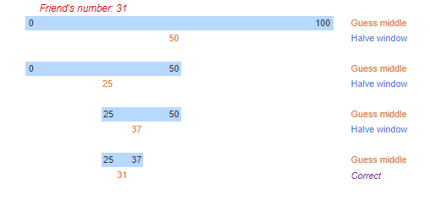
Binary Search Algorithm Example

Slide 16
Binary Search Animation

Slide 17
Binary Search by Too Tall Productions
https://www.youtube.com/watch?v=8TNLRK_FyFc

Slide 18
Interpreting Binary Search with Flamenco Dance
https://www.youtube.com/watch?v=wz7XgKowJIg

Slide 19
Binary Search
Look at examples:
BinarySearchWithoutRecursion.cpp
BinarySearchWithRecursion.cpp

Slide 20
Binary Search Good Bad and Ugly
GOOD:
Easy to understand
Time Efficient – much quicker then linear search
Space Efficient – doesn’t take up much space at all to run
BAD:
Data must be sorted

Slide 21
Number of Comparisons in Binary Search Algorithm
MAXIMUM: ┌ log₂ N ┐ comparisons
Powers of 2 are used to calculate the maximum number of comparisons the binary search will make on an array/list of any size. Simply find the smallest power of 2 that is greater than or equal to the number of elements in the array.
Example: array of 50,000 elements
2¹⁶ = 65,536 (maximum of 16 comparisons would be made on a 50,000 array)
┌log₂ 50,000┐= 16

Slide 22
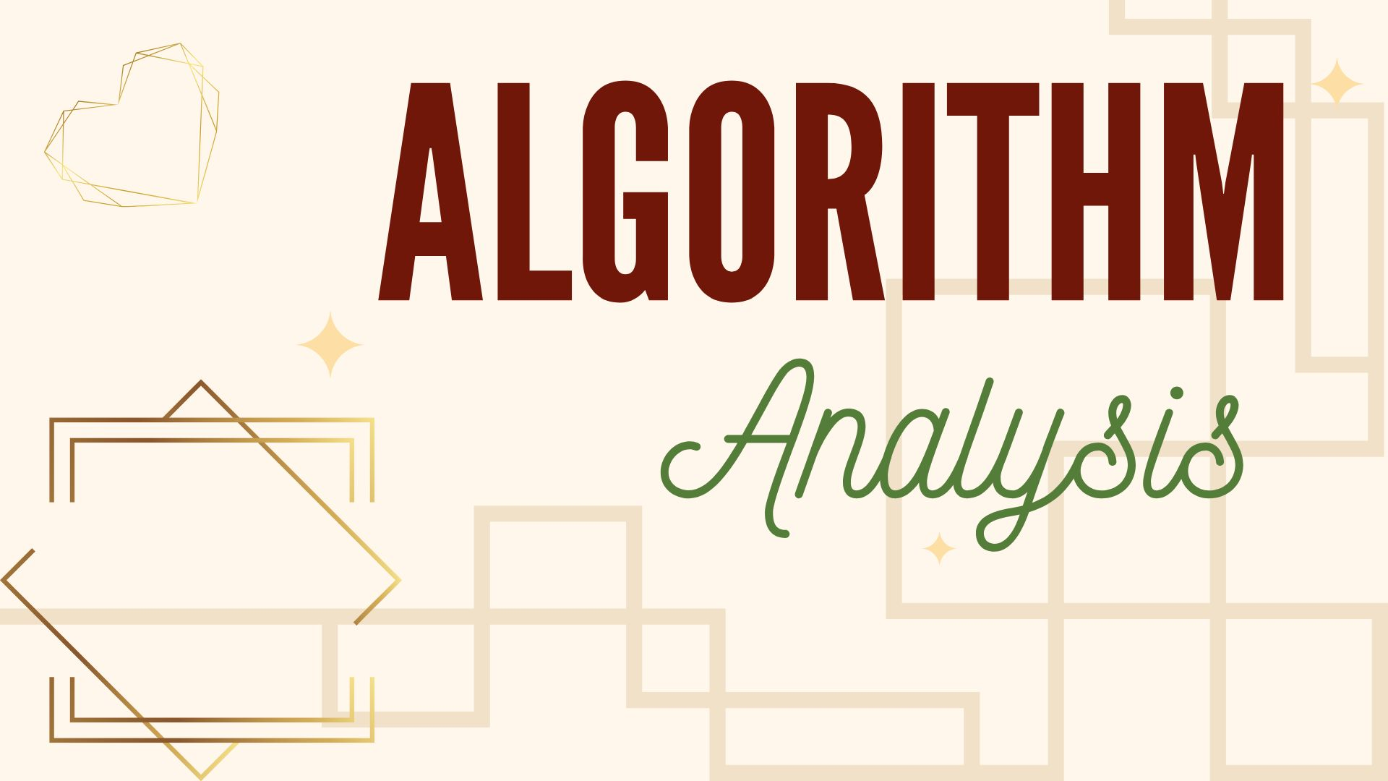
Algorithm Analysis

Slide 23
Efficiency & Growth Rate
The more elements, the longer it will take to do different operations (and therefore algorithms) using these elements.
If an algorithm does a good job of not taking too much longer when adding more elements, then it has a slower growth rate.
If an algorithm is waaayyyyyyy slower when adding more elements, then it has a higher growth rate.

Slide 24
Big-O Notation
Big-O notation is a mathematical way to describe the efficiency class of an algorithm to some function of n, where n is usually the number of elements in a collection.
Example: if an algorithm is O(n), it means that the running time of the algorithm is roughly proportional to the number of elements in the collection.
The ‘O’ in big-O stands for “On the Order Of”

Slide 25
Other Notations in Algorithm Analysis
O notation provides a growth rate for an algorithm's upper bound. This is the absolute worst this algorithm could ever get.
Ω notation provides a growth rate for an algorithm's lower bound. This is the best this algorithm could ever get.
Θ notation provides a growth rate that is both an upper and lower bound. This is the average for this algorithm.

Slide 26
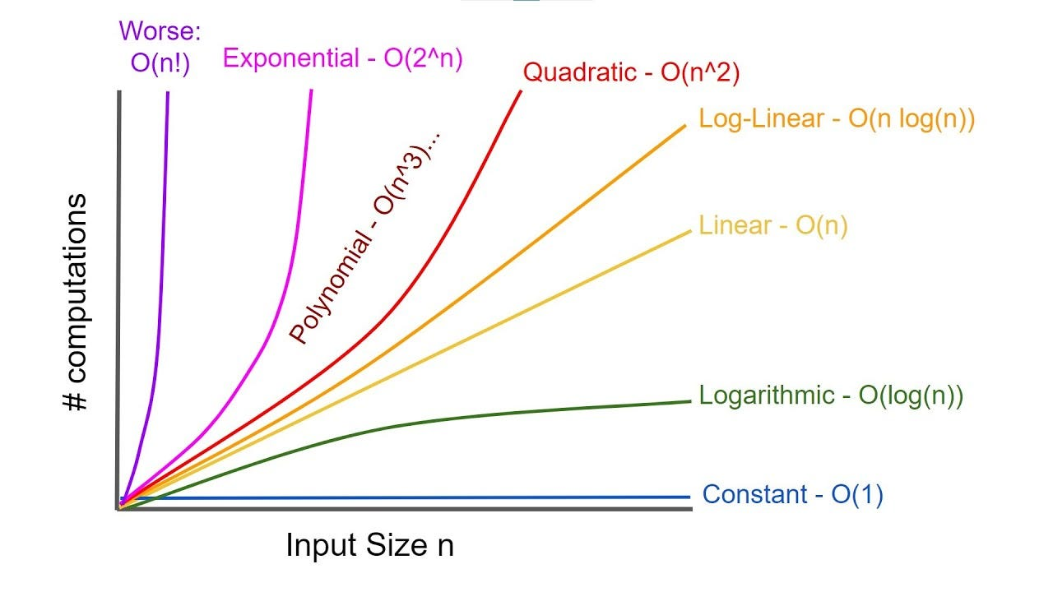
Common Efficiency Classes In Order of Growth Rate from slowest growth rate (good) to highest growth rate (bad)
(n is the number of items in a list)
1
log n
n
n log n
n²
2^{n}
n!

Slide 27
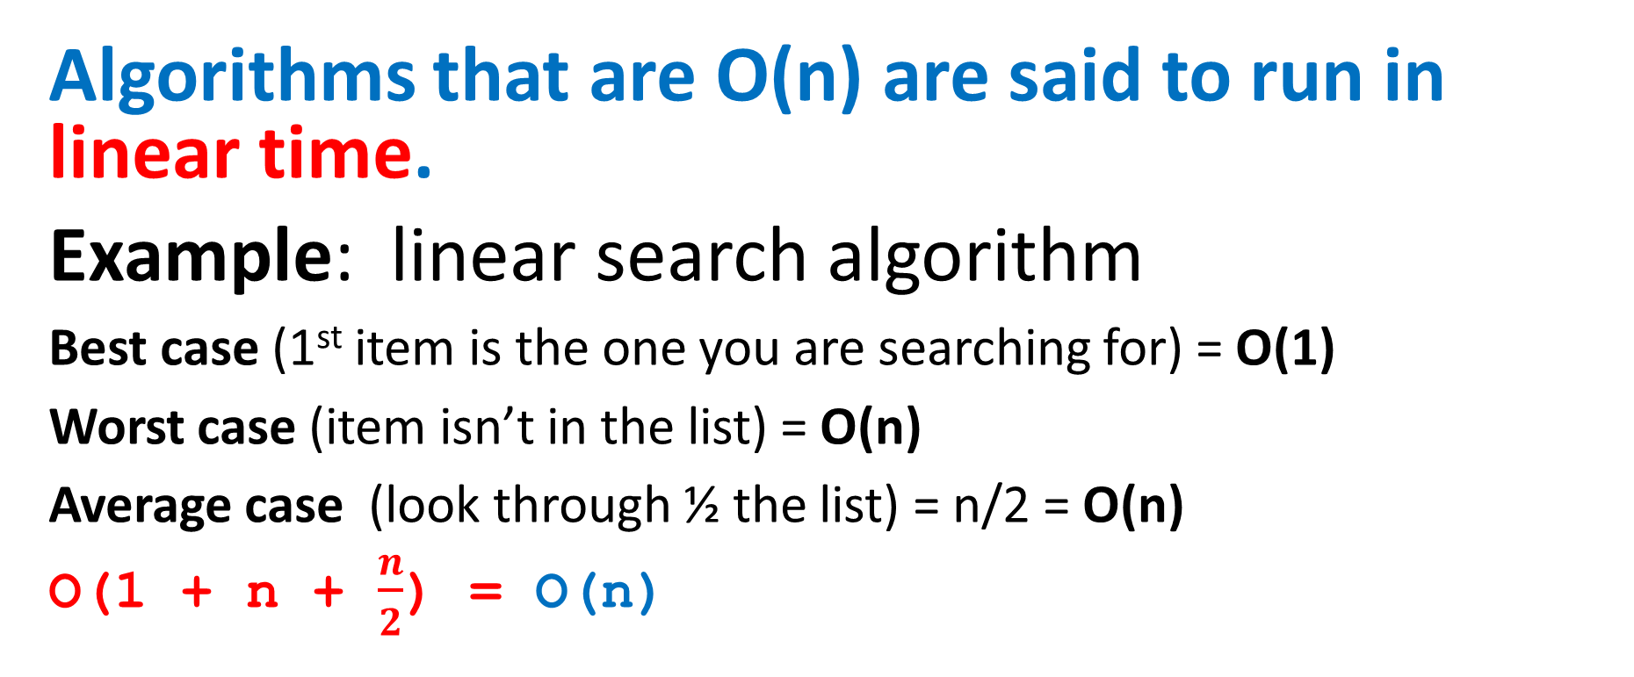
Big-O Notation – Linear Time
Algorithms that are O(n) are said to run in linear time.
Example: linear search algorithm
Best case (1st item is the one you are searching for) = O(1)
Worst case (item isn’t in the list) = O(n)
Average case (look through ½ the list) = n/2 = O(n)
O(1 + n + $\frac{n}{2}$) = O(n)

Slide 28
Big-O Notation – Quadratic Time
Algorithms that are O(n²) are said to run in quadratic time.
Example: bubble sort
Bubble sort (shown in detail later) rearranges the elements of an array in order from smallest to largest.

Slide 29
Big-O Notation – Logarithmic Time
Algorithms that are O(log N) are said to run in logarithmic time.
Example: binary search

Slide 30
Big-O Notation – Exponential Time
Algorithms that are O(c ^{N}) are said to run in exponential time.
(c is a constant)
Example: any algorithm that prints every possible N-letter combination. Since there are 26^{N} possible N-letter combinations in English any such algorithm would be O(26^{N} )

Slide 31
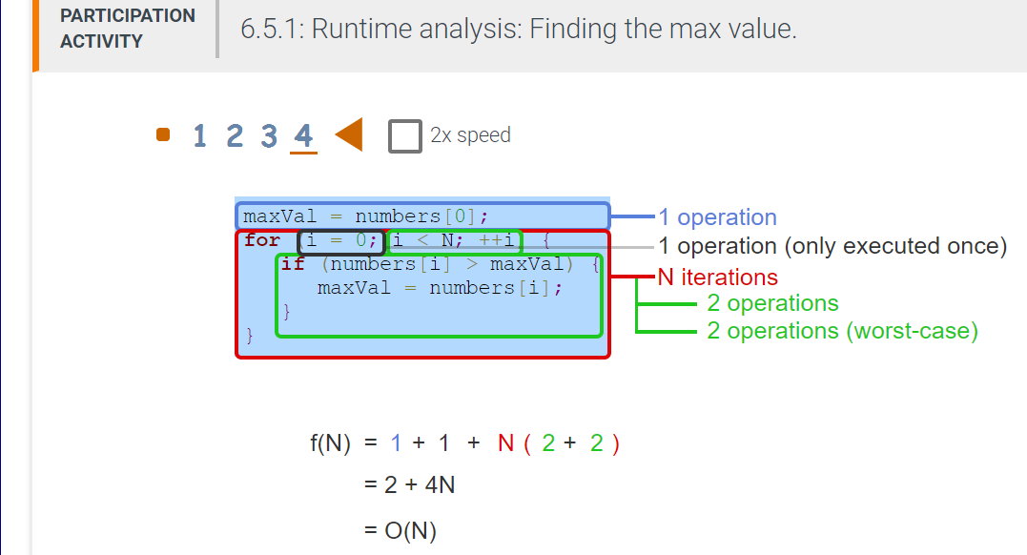
Example of Finding Big-O

Slide 32
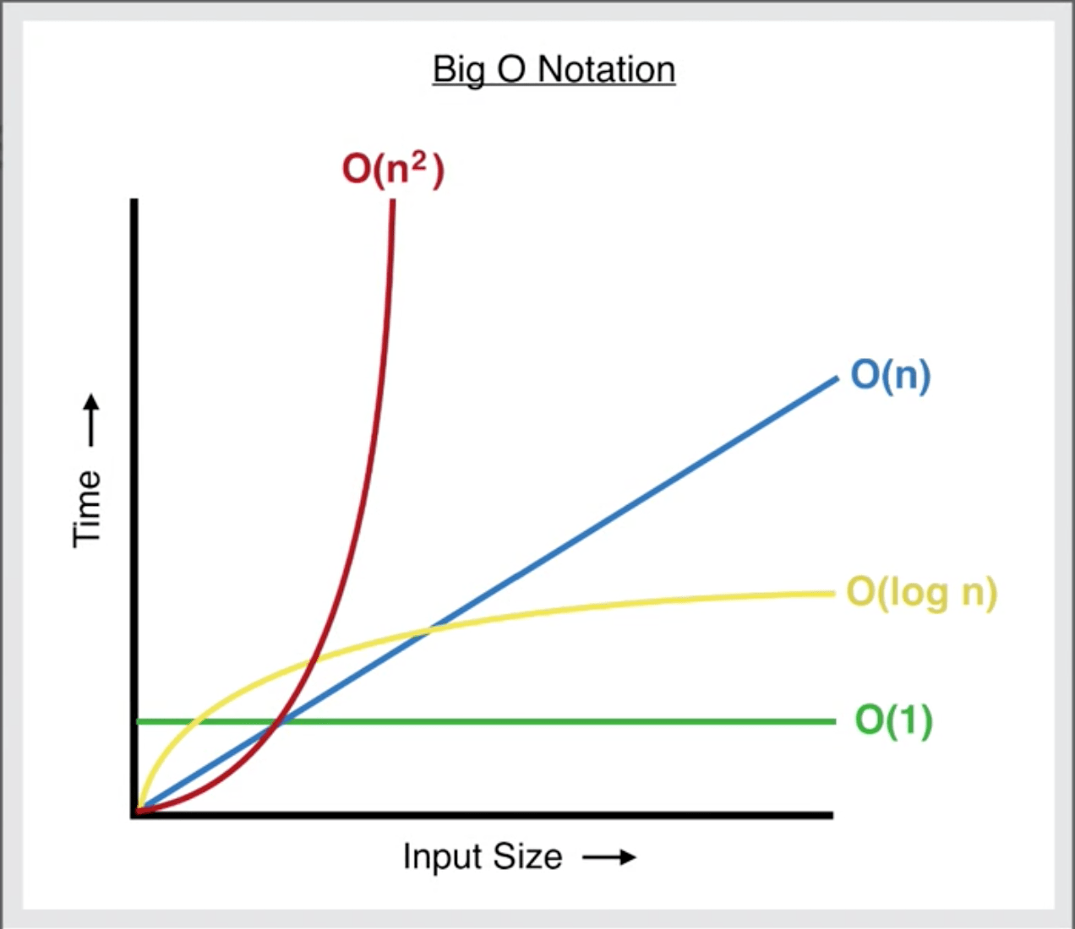
Linear Search Big O Notation
Runtime Best Case: O(1)
Runtime Average Case: O(n)
Runtime Worst Case: O(n)

Slide 33
Binary Search Big O Notation
Runtime Best Case: O(1)
Runtime Average Case: O(log n)
Runtime Worst Case: O(log n)
Best case is when the item is found in the middle (first comparison)!
Worst case is at most log n + 1 comparisons

Slide 34
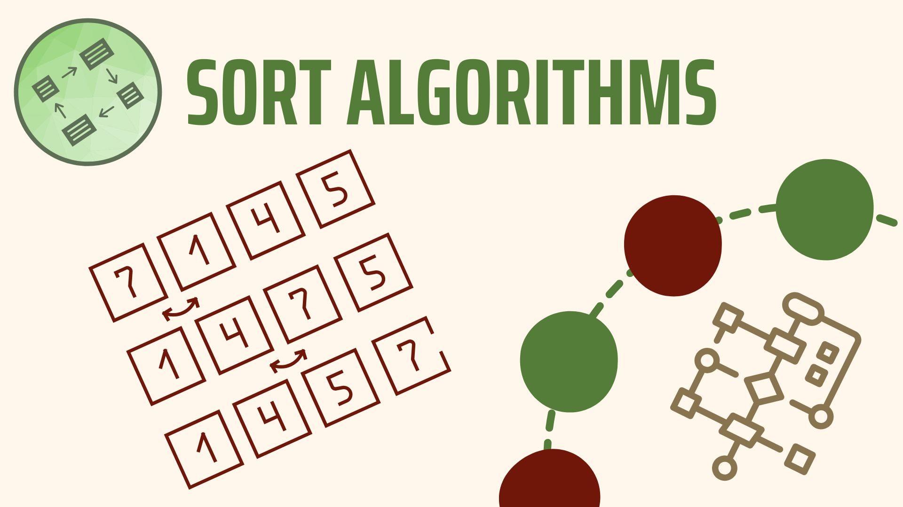
Sort Algorithms

Slide 35
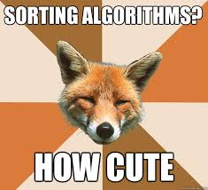
What is a Sort Algorithm?
A sort algorithm is used to arrange data (or items) in order.
Alphabetically
Numerically

Slide 36
Ascending / Descending Order
Ascending order – increasing in size or importance
Descending order – decreasing in size or importance
85 | 42 | 7 | 186 | 18
7 | 18 | 42 | 85 | 186
186 | 85 | 42 | 18 | 7

Slide 37
Visualization of 24 Sort Algorithms in 2 Minutes
https://www.youtube.com/watch?v=BeoCbJPuvSE&t=2s

Slide 38

Bubble Sort

Slide 39
What is Bubble Sort?
Bubble sort is a simple sorting algorithm that repeatedly steps through the list or array to be sorted, compares each pair of adjacent items, and swaps them if they are in the wrong order.
REPEATEDLY COMPARE NEIGHBOR PAIRS AND SWAP IF NECESSARY

Slide 40
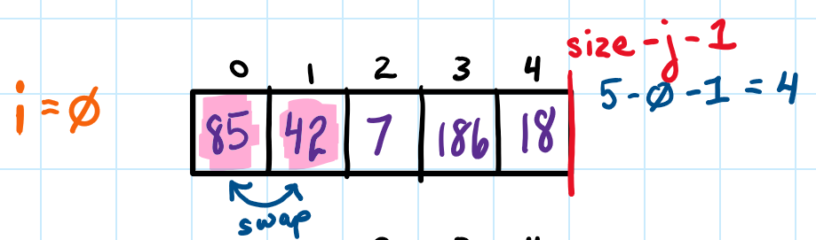
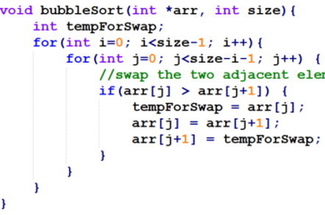
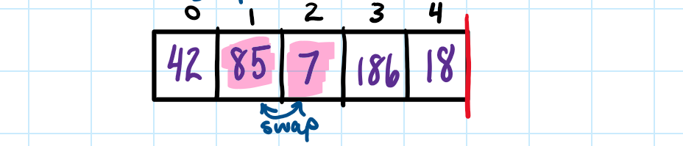
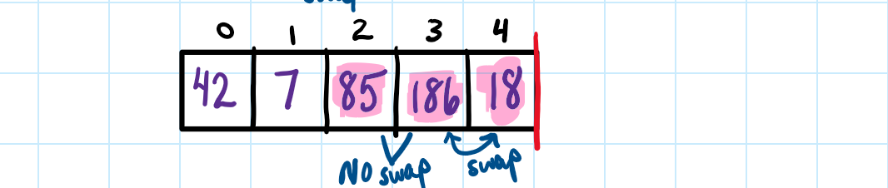
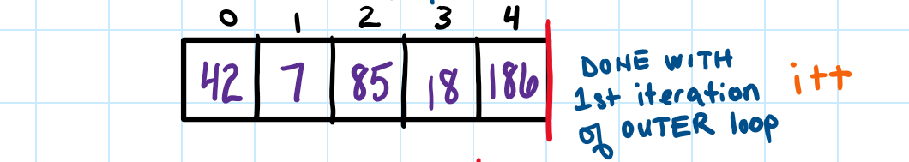
Bubble Sort Example with an Array, slide 1

Slide 41
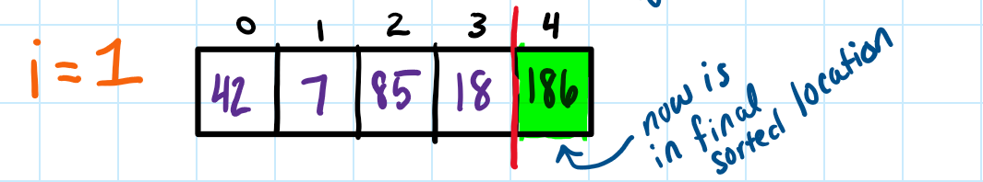
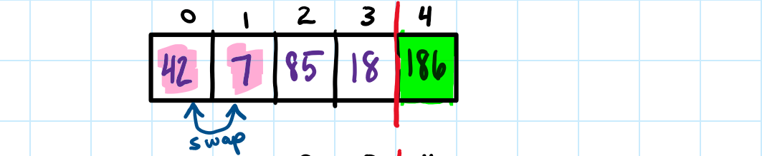
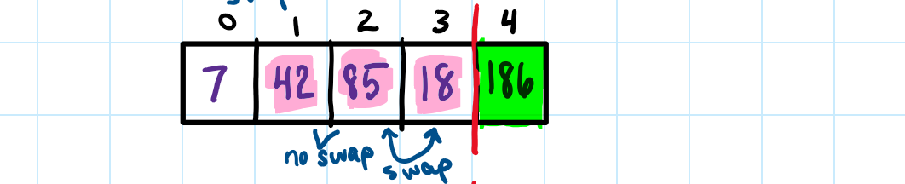
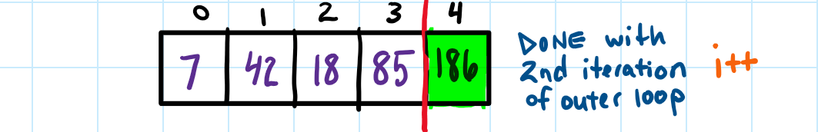
Bubble Sort Example with an Array, slide 2

Slide 42
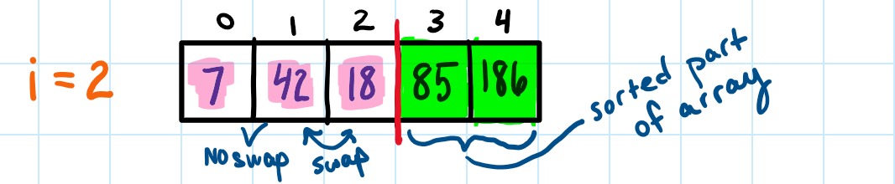
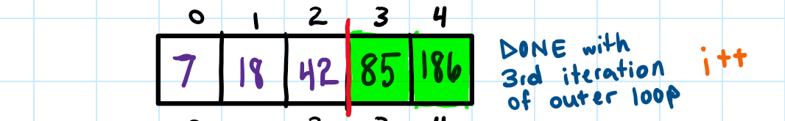
Bubble Sort Example with an Array, slide 3

Slide 43
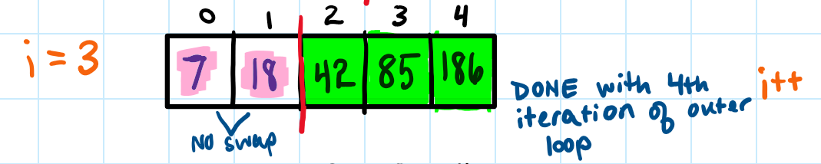
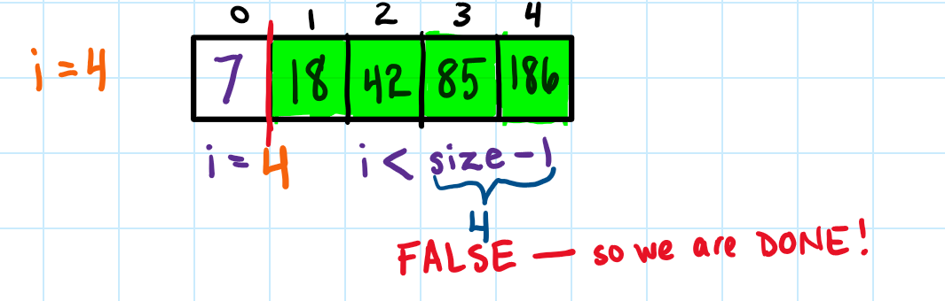
Bubble Sort Example with an Array, slide 4

Slide 44

Bubble Sort 3D Animation
https://www.youtube.com/watch?v=NiyEqLZmngY

Slide 45
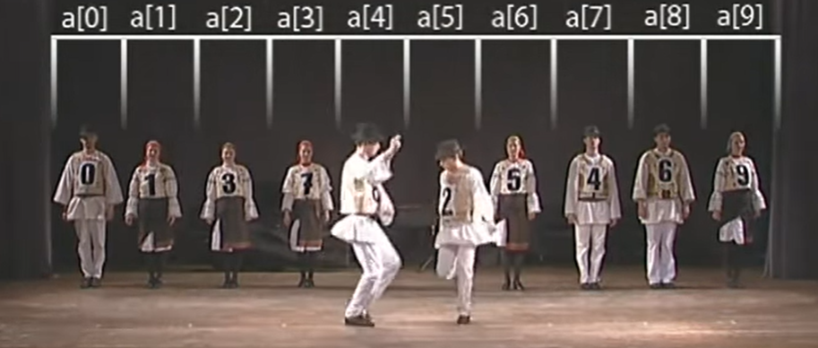
Bubble Sort with Hungarian, Folk Dance
https://www.youtube.com/watch?v=Iv3vgjM8Pv4

Slide 46
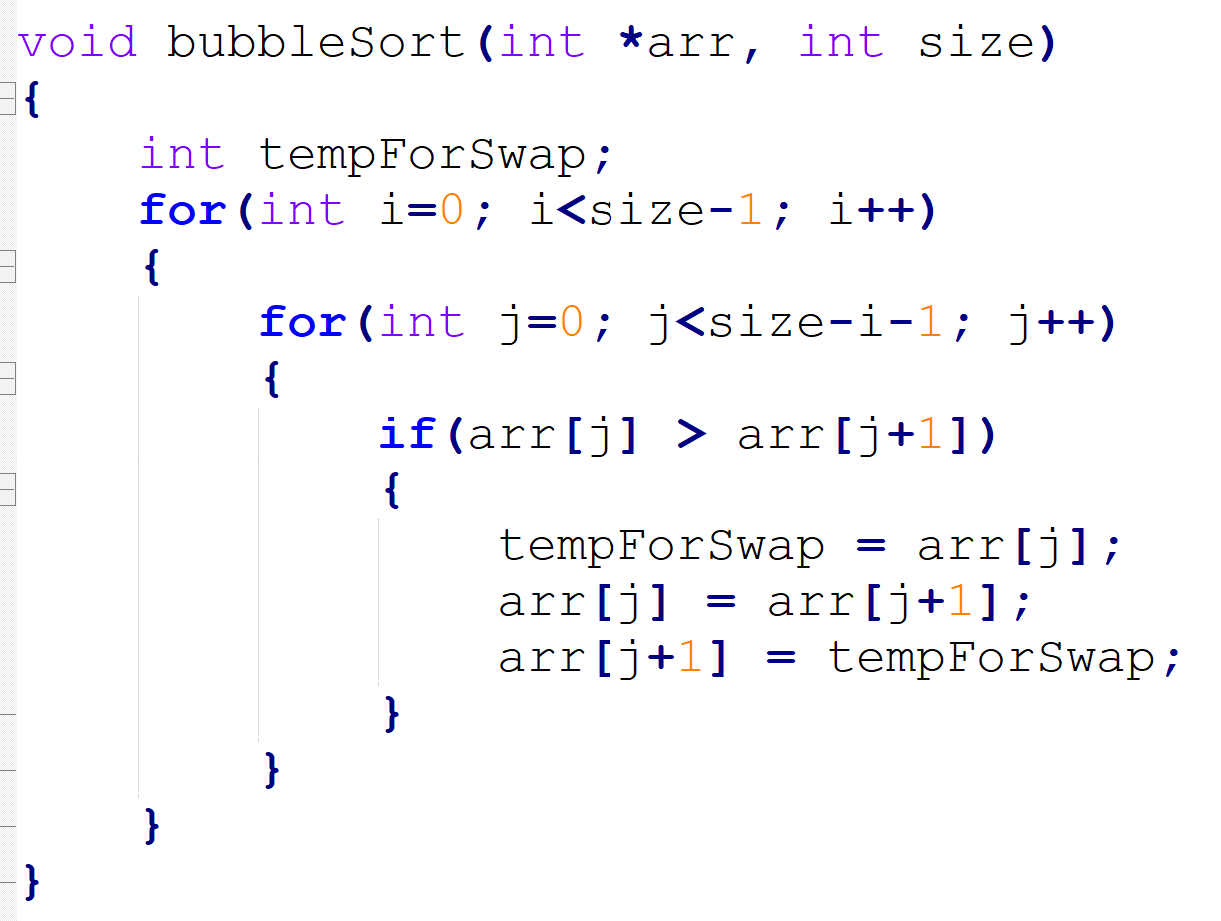
Bubble Sort Code
Compare adjacent elements.
If the one on the left is larger than the one on the right, they should be swapped.

Slide 47
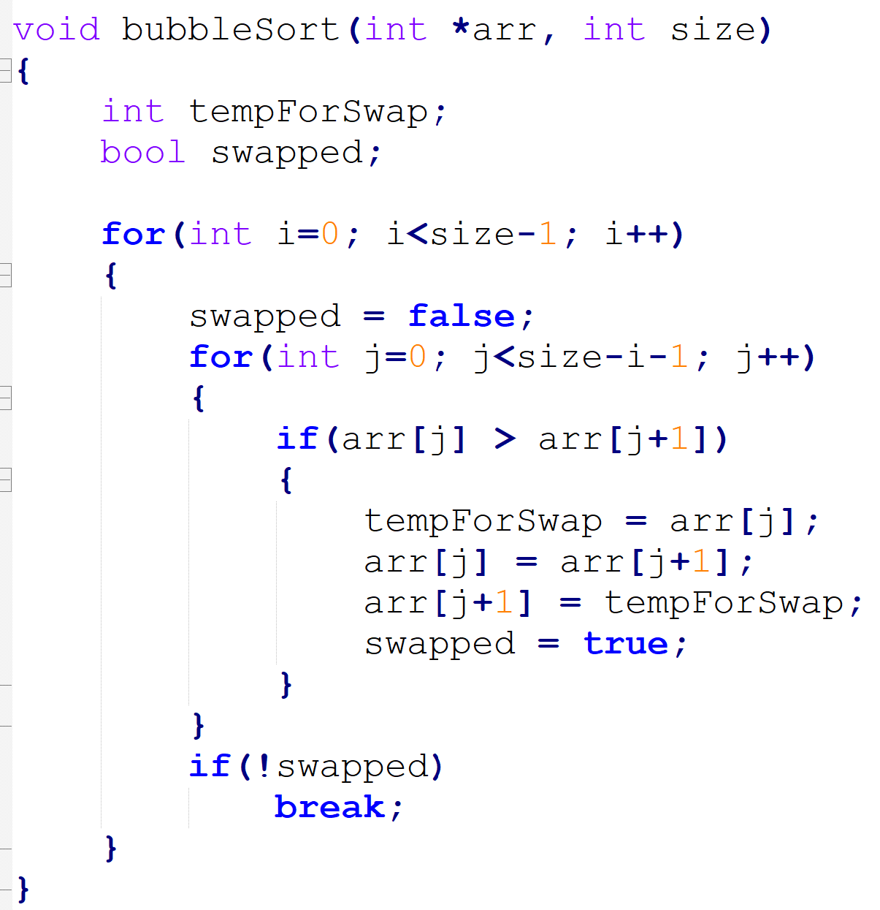
IMPROVED Bubble Sort Code
Improved code will check to see if any elements were swapped in the current pass through the array. If not, then break.
Will reduce the number of passes through the array.

Slide 48
Bubble Sort Examples
bubbleSort.cpp – original (inefficient) version of bubble sort
bubbleSortEfficient.cpp – improved, more efficient version of bubble sort
bubbleSortExamine.cpp – also the improved version of bubble sort and prints out everything it is doing

Slide 49
Bubble Sort: best & worst-case efficiency
BEST – when the array is already sorted! You would only have to pass through the array one time and compare each array element once, so there would be n comparisons where n is the number of elements!
WORST – when the array is in the completely decreasing order – maximum number of comparisons, which is n²

Slide 50
Bubble Sort Big O Notation
Runtime Best Case: O(n)
Runtime Average Case: O(n²)
Runtime Worst Case: O(n²)
Space Complexity : O(1)
Bubble sort is not a practical sorting algorithm when n is large. However, an o.k. algorithm if n is small and you need to write something quick.

Slide 51
Bubble Sort Visualizations
https://visualgo.net/bn/sorting?slide=6
https://www.cs.usfca.edu/~galles/visualization/ComparisonSort.html

Slide 52
Your Turn (Module 4 Practice)

Slide 53
Selection Sort

Slide 54
What is Selection Sort?
Selection sort is a sort algorithm that repeatedly searches remaining items to find the smallest one and moves it to its final location.
REPEATEDLY SELECT THE SMALLEST ELEMENT TO PLACE IN SORTED LOCATION

Slide 55
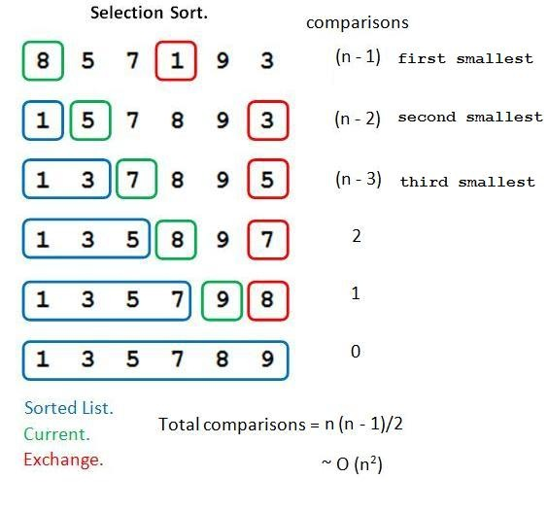
Selection Sort

Slide 56
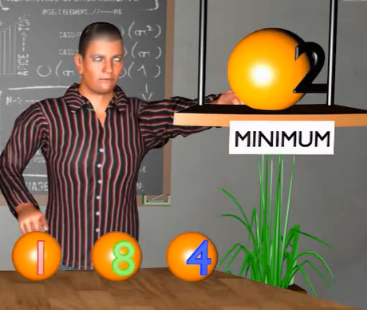
Selection Sort 3D Animation
https://www.youtube.com/watch?v=EdUWyka7kpI

Slide 57
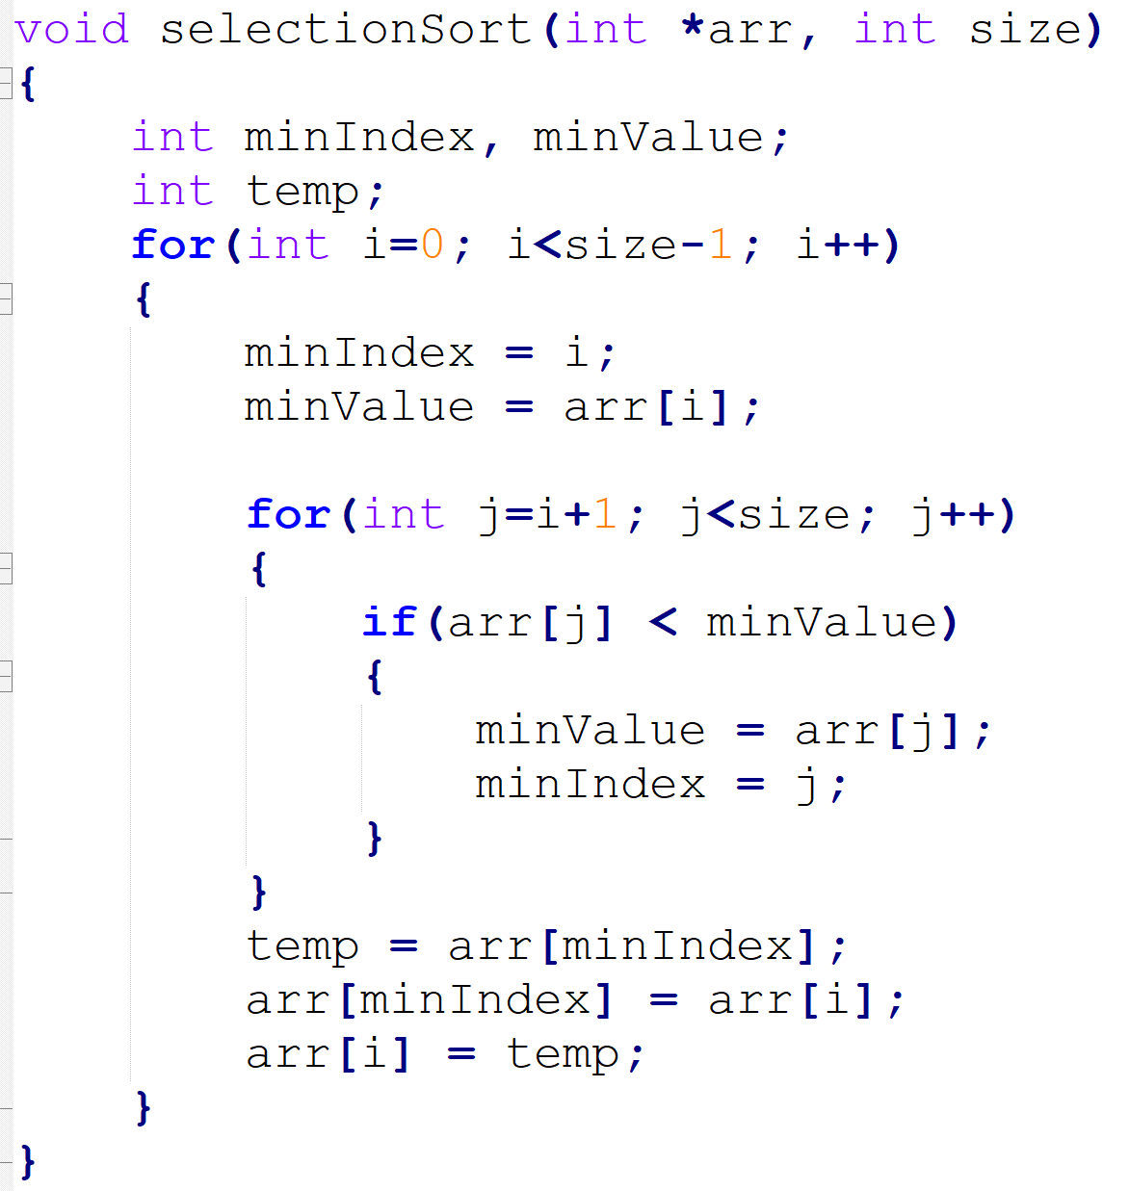
Selection Sort Code

Slide 58
Selection Sort Examples
selectionSort.cpp
selectionSortExamine.cpp

Slide 59
Selection Sort Big O Notation
Runtime Best Case: O(n²)
Runtime Average Case: O(n²)
Runtime Worst Case: O(n²)
Space Complexity : O(1)
Selection sort usually performs fewer swaps then bubble sort because it moves items immediately to their final position in the array.

Slide 60
Selection Sort Visualizations
https://visualgo.net/bn/sorting?slide=7
https://www.cs.usfca.edu/~galles/visualization/ComparisonSort.html

Slide 61
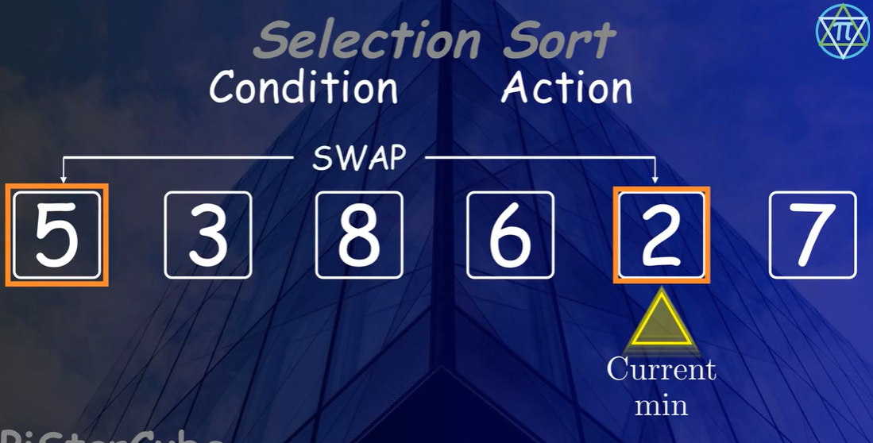
Selection Sort Explained with Animation | Step-by-Step for Interviews and Beginners
https://www.youtube.com/watch?v=3hpTzpvSzfg

Slide 62
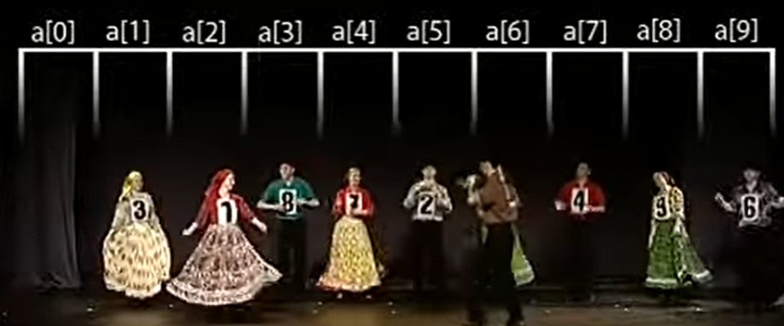
Selection Sort with Gypsy Folk Dance
https://www.youtube.com/watch?v=hFhf9djnM5A

Slide 63
Insertion Sort

Slide 64
What is Insertion Sort?
Insertion sort is a simple sort algorithm that builds the final sorted array (or list) one item at a time. The values to the left of the one item are sorted and the items to the right are not sorted. There is no swapping.
REPEATEDLY INSERT NEW ELEMENT TO THE SORTED RESULT

Slide 65
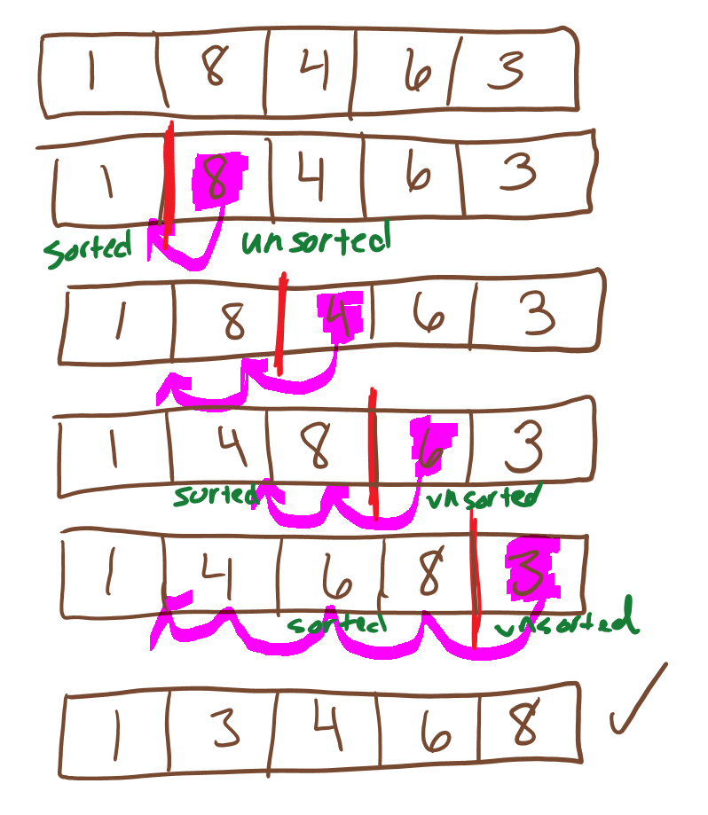
Insertion Sort Example

Slide 66
Insertion Sort in 2 minutes
https://www.youtube.com/watch?v=JU767SDMDvA

Slide 67
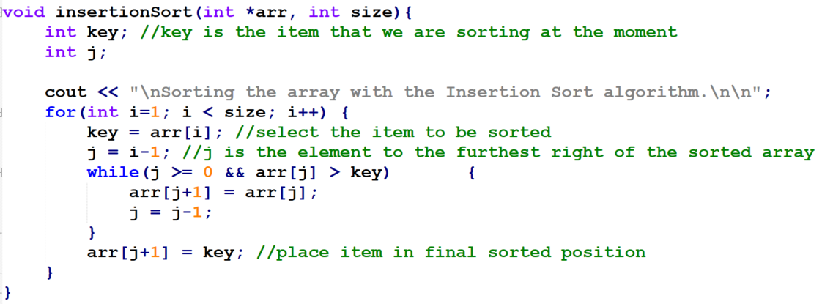
Insertion Sort Code

Slide 68
Insertion Sort Examples
insertionSort.cpp
insertionSortExamine.cpp

Slide 69
Insertion Sort Worst, Best & Average Case
BEST – when there is an array that is already sorted!
WORST – when there is an array of strictly decreasing values.
AVERAGE – based on how many elements are out of order – the result is that on average there are ½ as many comparisons than worst case.

Slide 70
Insertion Sort Big O Notation
Runtime Best Case: O(n)
Runtime Average Case: O(n²)
Runtime Worst Case: O(n²)
Space Complexity : O(1)

Slide 71
Insertion Sort Comparison
Although the average case efficiency is the same for Bubble Sort, Selection Sort & Insertion sort, the average number of comparisons for insertion sort is usually smaller in practice.
Insertion Sort is the preferred SIMPLE sorting algorithm.

Slide 72
Insertion Sort Visualization
https://visualgo.net/bn/sorting?slide=8
https://www.cs.usfca.edu/~galles/visualization/ComparisonSort.html

Slide 73

Quick Sort

Slide 74
What is Quick Sort?
Quicksort is a sort algorithm that utilizes a divide-and-conquer strategy to quickly sort data items by dividing a large array into two smaller arrays using partitioning.

Slide 75
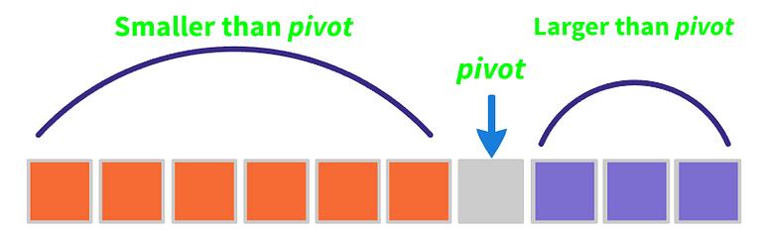
Quick Sort Explained
Quicksort finds the element called the pivot, which divides the array into two parts in such a way that
elements in the left half are smaller than pivot and
elements in the right half are greater than pivot.
Follow three steps recursively:
Find pivot that divides the array into two parts.
Quick sort the left part.
Quick sort the right part.

Slide 76
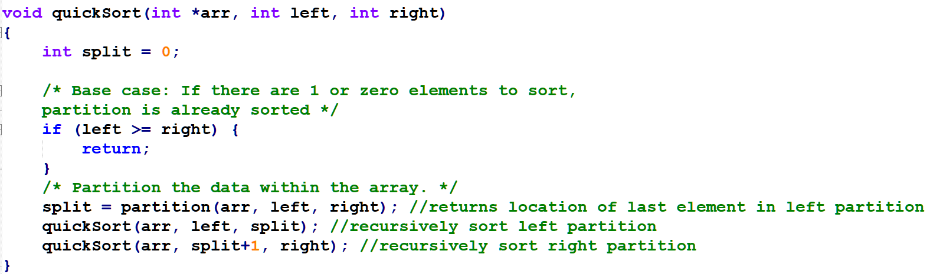
Quick Sort Code

Slide 77
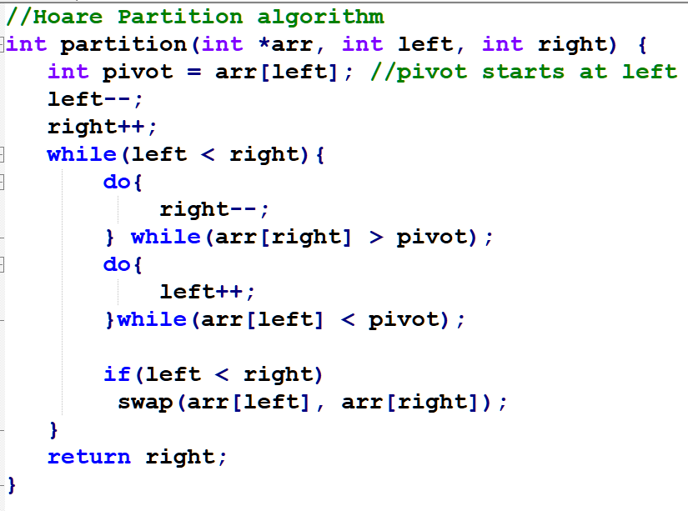
Hoare Partition Algorithm

Slide 78
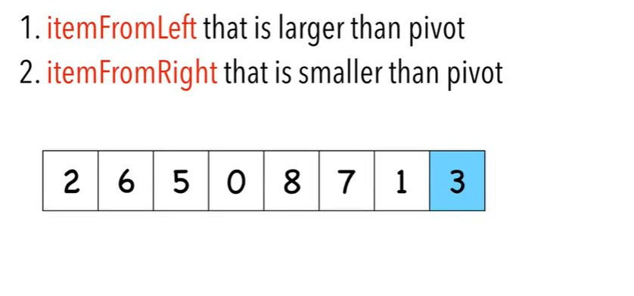
Quick sort in 4 minutes
https://www.youtube.com/watch?v=Hoixgm4-P4M&t=19s

Slide 79
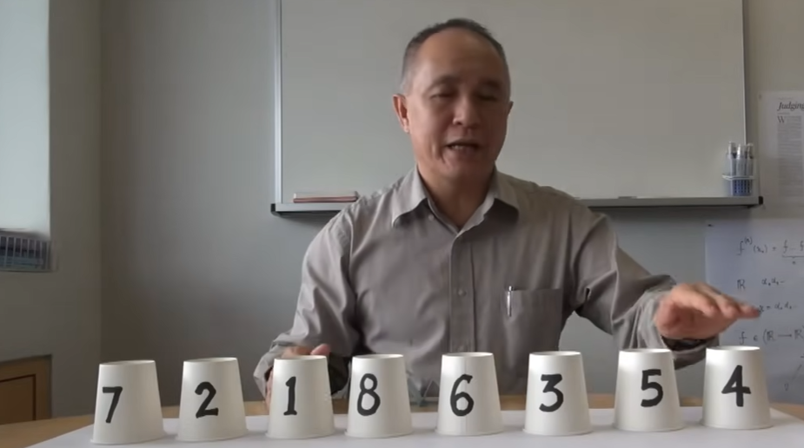
Quicksort: Partitioning an Array with Pivot
https://www.youtube.com/watch?v=MZaf_9IZCrc

Slide 80
Quick Sort Examples
quicksort.cpp

Slide 81
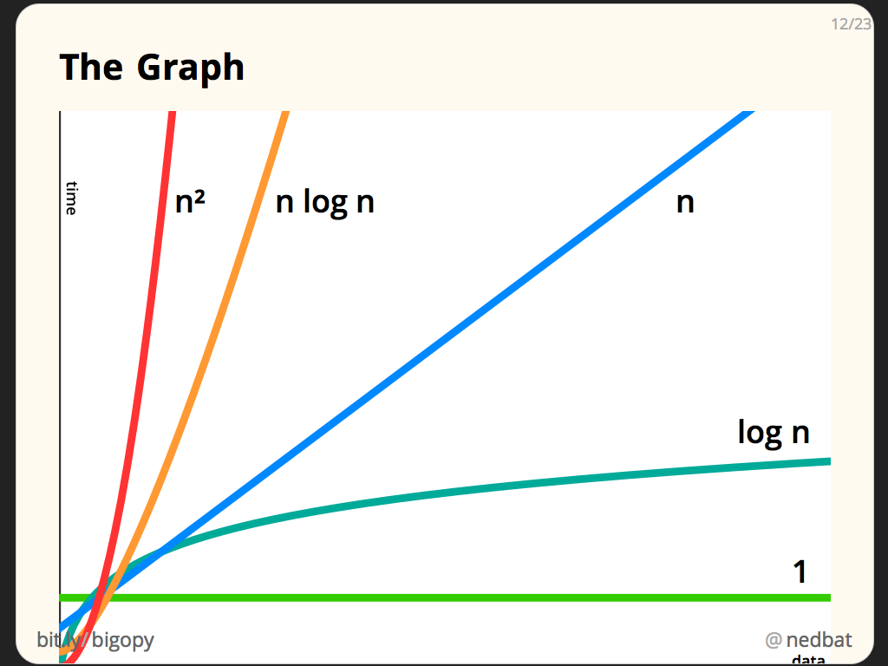
Quick Sort Big O Notation
Runtime Best Case: O(n log n)
Runtime Average Case: O(n log n)
Runtime Worst Case: O(n²)
Space Complexity : O(log n)
Fast in practice, more complex to write, requires more space then other simpler algorithms.

Slide 82

Quick Sort at VisualGo.net
https://visualgo.net/bn/sorting?slide=11

Slide 83
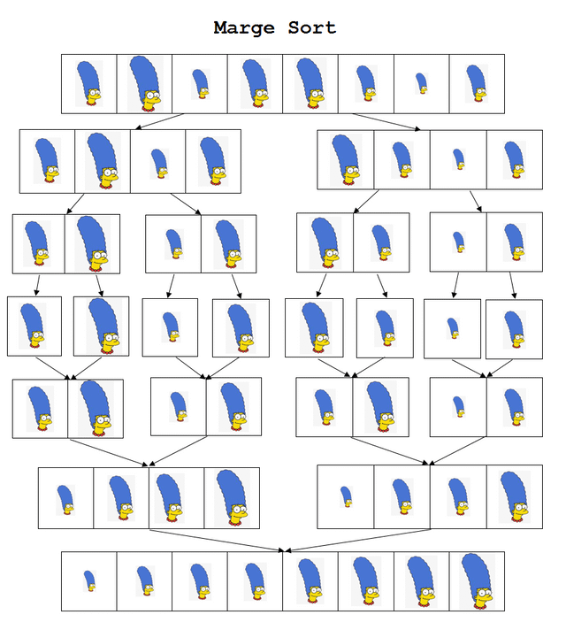
Merge Sort

Slide 84
What is Merge Sort?
Merge sort is a divide-and-conquer sorting algorithm that divides a list into two halves, recursively sorts each half, and then merges the sorted halves to produce a sorted list. It is implemented as a recursive function.

Slide 85

Merge Sort 3D Animation
https://www.youtube.com/watch?v=HsZ-YRQM8sE&t=41s

Slide 86
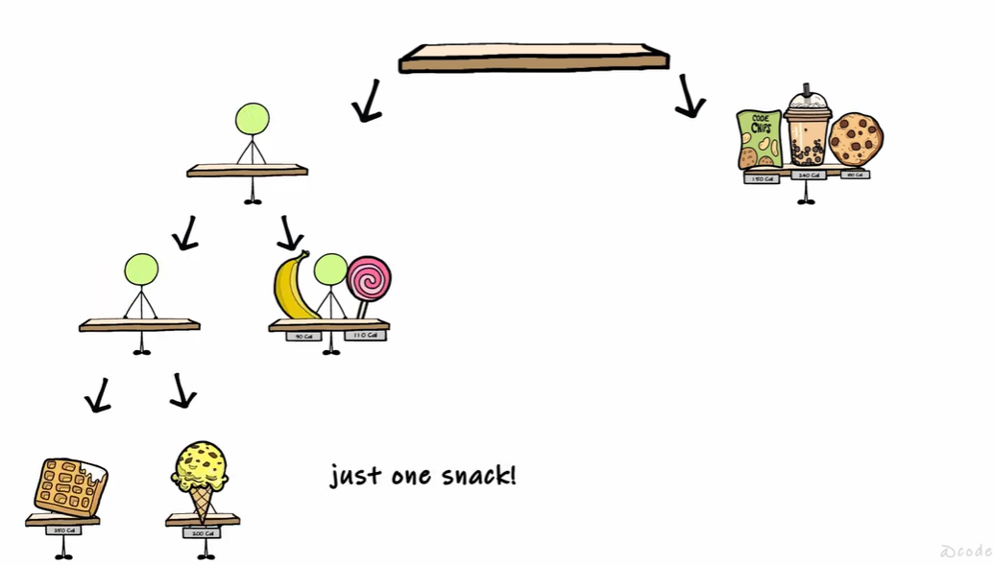
Merge Sort Algorithm – Animated Explanation in 5 minutes
https://www.youtube.com/watch?v=cdqmX8wz4H4

Slide 87
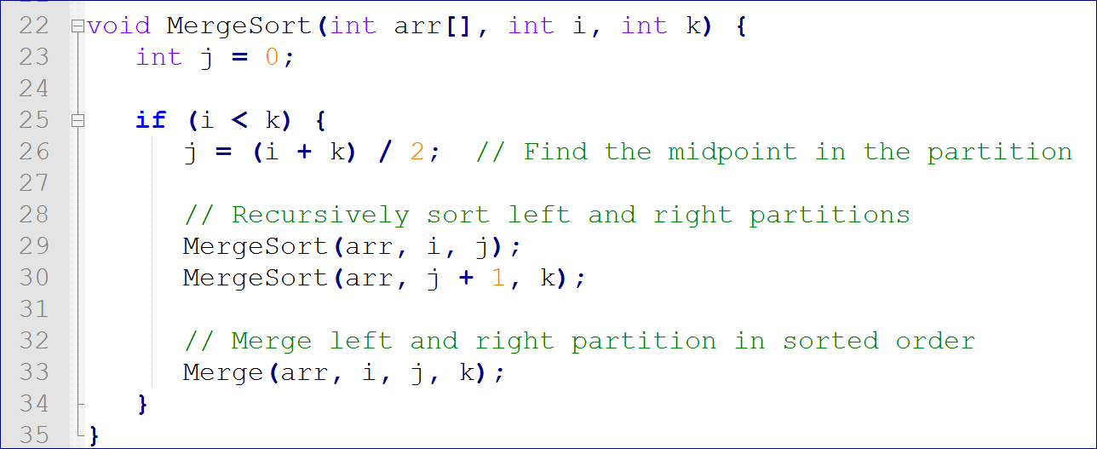
Merge Sort Code

Slide 88
Merge Sort Examples
mergeSort.cpp

Slide 89
Merge Sort Big O Notation
Runtime Best Case: O(n log n)
Runtime Average Case: O(n log n)
Runtime Worst Case: O(n log n)
Space Complexity : O(n)
Fast in practice – faster then quick/selection/insertion/bubble. Requires more space.
https://en.wikipedia.org/wiki/Merge_sort

Slide 90
Merge Sort at VisualGo.net
https://visualgo.net/bn/sorting?slide=10

Slide 91

Writing Parallel Algorithms (instead of Sequential)

Slide 92


In-Class Pre-Quiz What do you know about writing parallel programs in C++? (11 multiple choice questions)
https://tntech.co1.qualtrics.com/jfe/form/SV_3UyI7vqTj8Od6aq

Slide 93
Parallel Searching (Data Parallelism)
We can take advantage of modern architecture having multiple cores (processors) when writing code.
Remember linear search is slower than binary search.
However, You can parallelize the linear search algorithm easily in C++ to improve efficiency.
Each processer searches through it’s own sub-section of the array. This is called data parallelism because the processors are dividing the data.
Here is a visualization: https://raw.githack.com/xiaoyuansuo51-webster/Flag_Coloring_Activity/refs/heads/main/parallel_search.html

Slide 94
Task Parallelism
Dividing data across processors but doing the same task with that data is data parallelism.
If you instead divide different tasks across processors, it is called task parallelism.
For example, say you want to do three things in a linked list: add a node, delete a node, and search for a value in a node. You could do these tasks one-at-a-time (sequentially) or in parallel.
Example visualizations:
https://cse.unl.edu/~cbourke/PDCatUNL/module-parallel-visual.html
https://raw.githack.com/xiaoyuansuo51-webster/Flag_Coloring_Activity/refs/heads/main/parallel_linked_list.html

Slide 95
Parallel Sorting
Sorting can be parallelized by breaking data into chunks, sorting them independently, and then merging results. This is another example of data parallelism.
Flagmaker activity visualization showing parallelizing loops to draw a flag: https://raw.githack.com/xiaoyuansuo51-webster/Flag_Coloring_Activity/refs/heads/main/parallel_flag_color_XSUO.html
Divide-and-conquer algorithms such as Merge Sort and QuickSort are well-suited for parallelization because each subproblem can be sorted independently in different threads.

Slide 96

Parallel Processing in C++ with OpenMP
We will use OpenMP to write parallel programs in C++
Details are in [PRESENTATION SLIDES] CS2 OpenMP Introduction

Slide 97
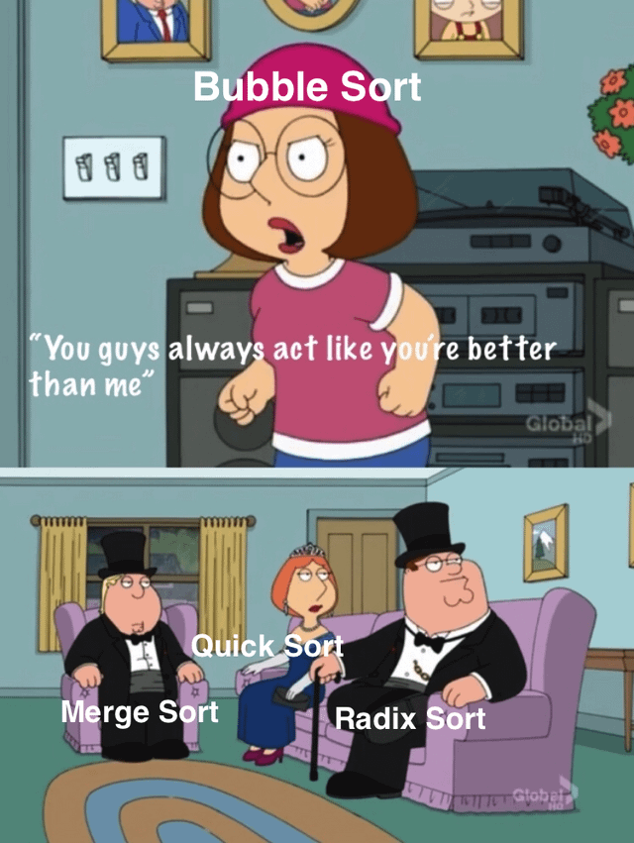
Radix Sort

Slide 98
What is Radix Sort?
Radix sort is a non-comparative sorting algorithm that sorts data by treating all data as character strings and then by grouping strings by the individual digits (characters) which share the same significant position and value.

Slide 99
Radix Sort Info
Different from all the other sorts so far because it does not compare the array’s entries.
Two kinds of radix sort
LSD – least significant digit
MSD – most significant digit
I am going to focus on LSD Radix sort

Slide 100
Radix Sort Example, slide 1
Step 1: Original, unsorted list or array:
Step 2: Treat each of these numbers as character strings and make all “strings” of equal length. With numbers, you would want to add zeros to the front of all which are not 3 digits so that they are all 3 digits (characters)
1
170 | 45 | 75 | 90 | 02 | 802 | 2 | 66
2
170 | 045 | 075 | 090 | 002 | 802 | 002 | 066

Slide 101
Radix Sort Example, slide 2
STEP 3: You will now create “buckets” to group these numbers in.
You will go from left to right & sort the list by LEAST SIGNIFICANT DIGIT (LSD), which is the 1’s place.
You will have 9 buckets, 1 for each digit, but I only show the buckets we need – a 0 bucket, a 2 bucket, a 5 bucket, and a 6 bucket.
170 | 045 | 075 | 090 | 002 | 802 | 002 | 066
0
2
5
6

Slide 102
Radix Sort Example, slide 3
Step 3 Result:
Step 4: Go from left to right & group list into buckets by next LSD, which is the 10’s place:
170 | 090 | 002 | 802 | 002 | 045 | 075 | 066
170 | 090 | 002 | 802 | 002 | 045 | 075 | 066
0
4
6
7
9

Slide 103
Radix Sort Example, slide 4
Step 4 Result:
002 | 802 | 002 | 045 | 066 | 170 | 075 | 090
Step 5: Go from left to right & group list into buckets by next LSD, which is the 100’s place:
002 | 802 | 002 | 045 | 066 | 170 | 075 | 090
0
1
8

Slide 104
Radix Sort Example, slide 5
Step 5 Result:
SORTED!
It is important to realize that each of the above steps requires just a single pass over the data, since each item can be placed in its correct bucket without having to be compared with other items.
002 | 002 | 045 | 066 | 075 | 090 | 170 | 802

Slide 105
Radix Sort Example
radixSort.cpp

Slide 106
Radix Sort Big O Notation
Runtime Worst Case: O(wn)
w = word size
n = number of elements / list nodes
Space Complexity : O(w + n)
https://en.wikipedia.org/wiki/Radix_sort

Slide 107
Summary of Big O Notation of Sorting Algorithms
Best Runtime | Best Runtime | Average Runtime | Worst Runtime | Space Complexity
BUBBLE SORT | O(n) | O(n²) | O(n²) | O(1)
INSERTION SORT | O(n) | O(n²) | O(n²) | O(1)
SELECTION SORT | O(n²) | O(n²) | O(n²) | O(1)
QUICK SORT | O(n log n) | O(n log n) | O(n²) | O(log n)
MERGE SORT | O(n log n) | O(n log n) | O(n log n) | O(n)
RADIX SORT |  | O(n) | O(wn) | O(w+n)

Slide 108
Worst Sort Algorithm Ever - Bogosort
Bogosort is a highly ineffective sorting that generates permutations of its input until it finds (maybe) one that is sorted.

Slide 109
Bogosort – worst sort algorithm
https://www.youtube.com/watch?v=DaPJkYo2quc

Slide 110
16 Sorts – Color Circle
https://www.youtube.com/watch?v=y9Ecb43qw98&t=1s

Slide 111
24 Sorting Algorithms in 2 Minutes!
https://www.youtube.com/watch?v=BeoCbJPuvSE

